Slide 1
Jonas Ole Langner
An online grammar course for students of German
LLAS e-learning symposium, 24./25.01.2013

Slide 2
German language teaching at Bristol
2010-11
since 2011-12
Integrated Skills classes (2.5 hrs per week)
Grammar lecture (1 hr per week)
Integrated Skills classes (3 hrs per week)
online grammar course
(? hrs per week)

Slide 3
Why?
grammar lectures not very well attended
students did not do exercises at home
students are mixed ability
students get more contact hours in small groups
enable students to work in their own time and at their own pace
enable students to become independent/
autonomous learners

Slide 4
The online grammar course
based on topics/structure of grammar lecture
accessed through blackboard (VLE)
a tutorial and a test almost every week (19 in total)
additional exercises in class/face to face tutorials
using Wimba Create and Questionmark Perception
started summer 2011 until Easter 2012; improvement work summer 2012
administer the course (reminders, reports, etc.)
online grammar course

Slide 5
Views by members of staff
workload
software
integration into teaching
attendance of face to face tutorials
availability to other students

Slide 6
Feedback from students
feedback forms in week 24 (n=38; out of 39)
overall:
84.2% think it is a good course!!!
94.3% thought that learning objectives and instructions were made clear

Slide 7
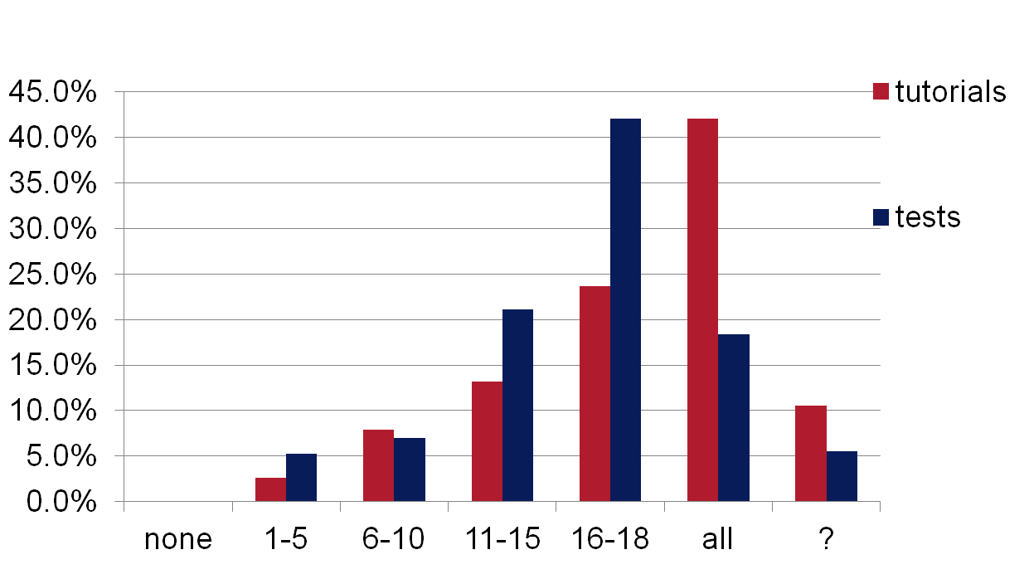
How many grammar tutorials/tests did you actually do?

Slide 8
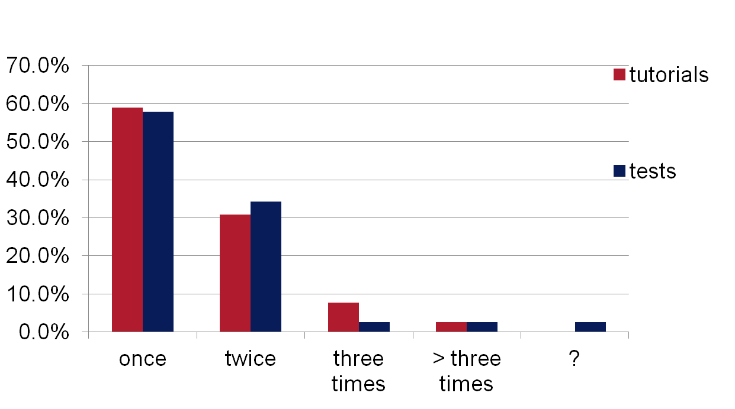
How often did you usually do a tutorial/test?

Slide 9
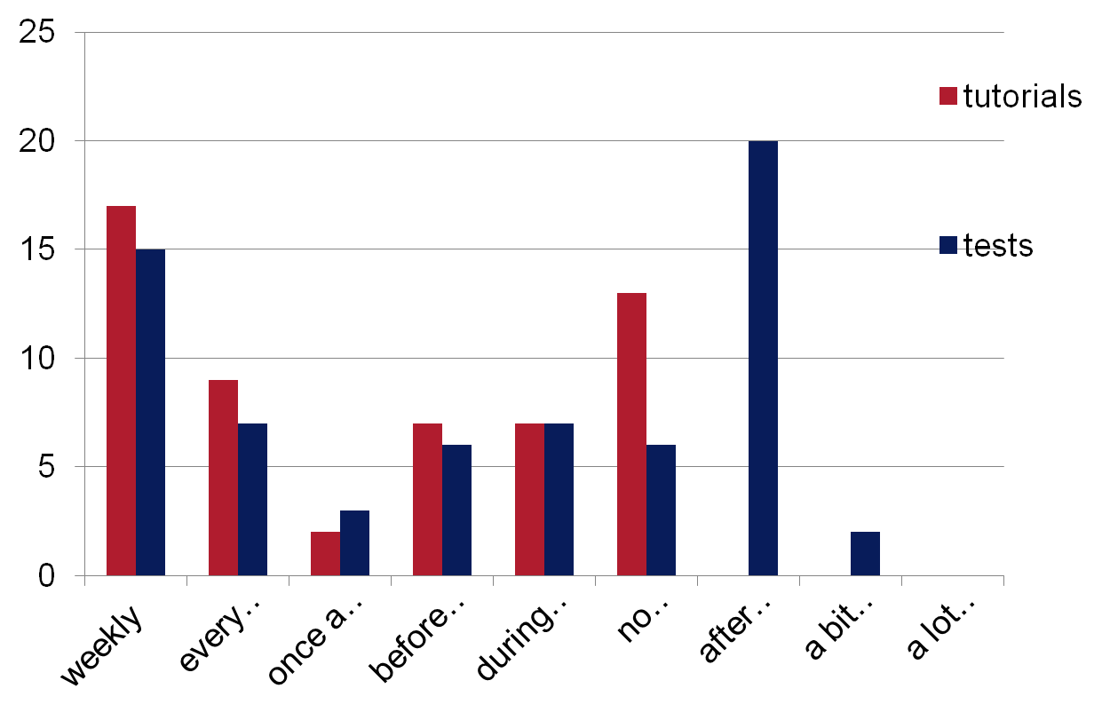
When did you normally do the tutorials/tests?

Slide 10
Reasons for not doing all tutorials/tests
reasons for repeating tutorials/tests
test result not satisfactory (4/14)
difficult (only for tutorial: 7)
revision (11/8)
“I forgot to” (8/4)
“had other – more important – things to do” (2/5)
“find them frustrating/pointless/
stressfull/etc.” (only for tests: 10)
reasons for doing tests without tutorial
“knew the grammar
topic” (8)
“covered in class” (3)

Slide 11
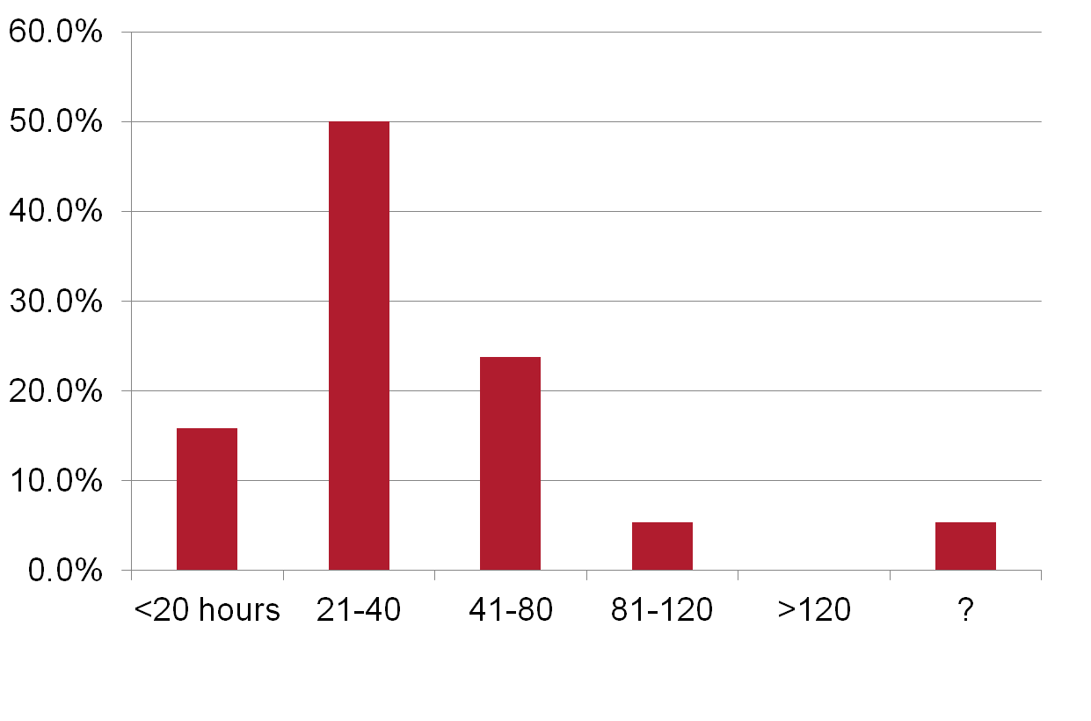
How much time did you roughly spend on the online grammar course?

Slide 12
Students’ grammar knowledge
change in assessment pattern
overall results in end-of-year grammar test seem to be better
those students with the worst results were those who had done fewer tests than all the others
good results did not necessarily mean successful completion of all test

Slide 13
advantages of the online grammar course (students)
instant feedback (1)
more time for other things in class (2)
easy to see what was expected in exam (13)
possibility to do tutorials/tests several times (8)
useful revision tool (6)
can be done in own time and anywhere (16)

Slide 14
disadvantages of the online grammar course (students)
unresponsive/no feedback/no corrections/
inaccessible (19)
no deadlines – easy to forget (4)
“I want to be taught by a real teacher” (3), this is essential for some topics (4); “you cannot ask questions” (2)
prefer other resources (paper test, grammar book) (2)
“yet another activity that requires the use of a computer”

Slide 15
How can we improve the course?
give more feedback and correct answers (10)
offer slot in class to go through online grammar course (3); have grammar lessons (3)
offer weekly face-to-face tutorials (3)
“make it compulsory” (2)
make the course available for Year 2 students (3)

Slide 16
Work over the summer:
review tutorials (structure, tests, pictures)
integrate grammar films by Year 2 students
give more (concise) feedback on tests
grammar slots in class (already done since TB 2)
make course available to Year 2 and 4 students for revision

Slide 17
Finally:
potential realised (mobile learning, revision tool)
offers (at least) another “contact” hour
blended learning is important
good and timely feedback is key
it requires a lot of time from students and staff

Slide 18
Contact details
Jonas Langner
Language Director, German
University of Bristol
School of Modern Languages
17 Woodland Road
Bristol, BS8 1TE
J.O.Langner@bristol.ac.uk

